Slide 1


183 DB Weekly Report
Week1 Team Parsley
Lin Li, Amir Omidfar, Wilson Chang, Angel ….

Slide 2
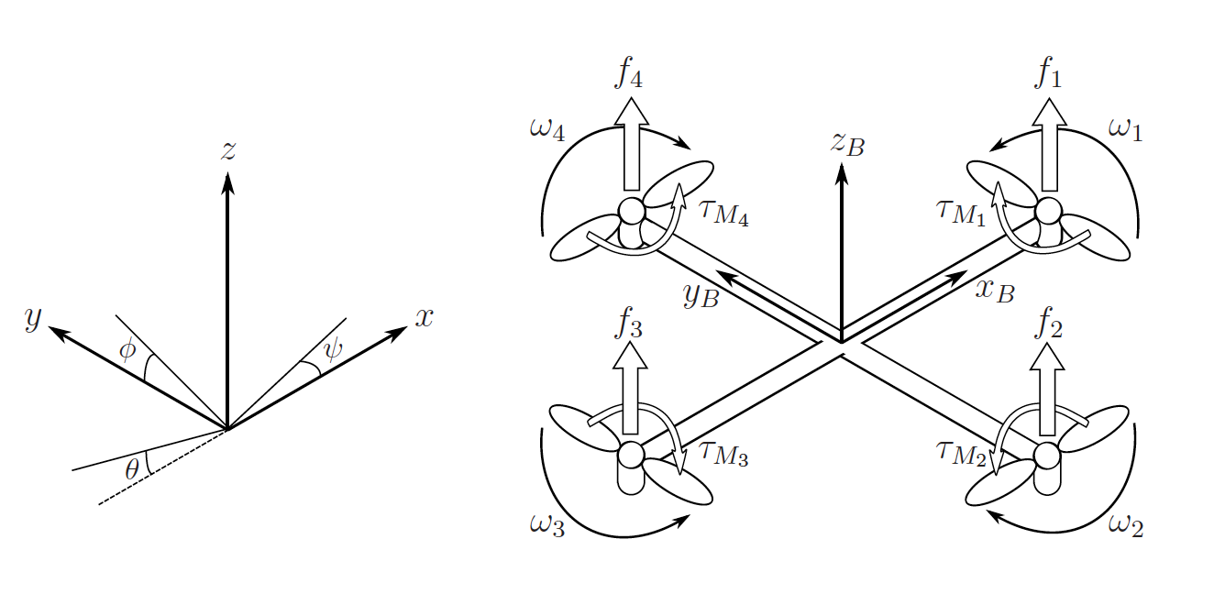
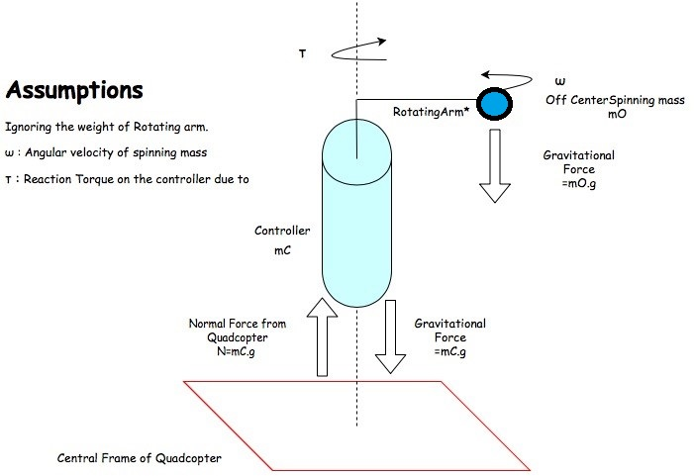
Free Body Diagrams
Quadcopter Free body Diagram [1]
Controller Free body Diagram

Slide 3
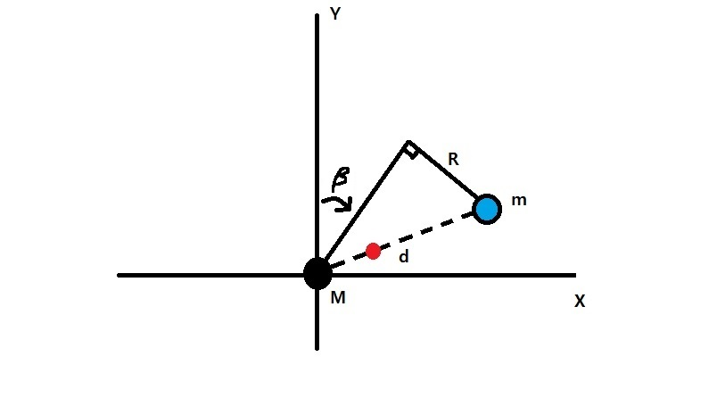
Mathematical Modeling
X: the horizontal axis
Y: the vertical axis
M: the mass of the quadcopter
m: the mass of the spinning object
R: the radius of the spinning object
d: the distance between the quadcopter and the spinning object
β: the pitching angle
g: the gravity constant (not shown on the figure)
Q: the ratio between the thrust and the gravity (not shown on the figure)

Slide 4
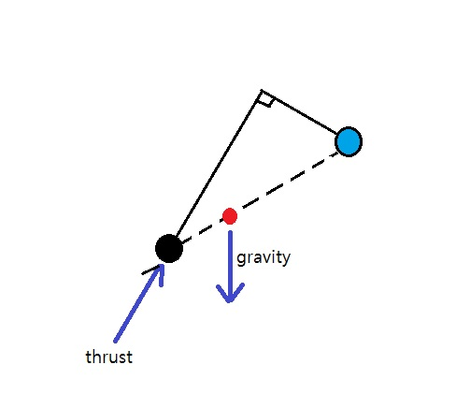
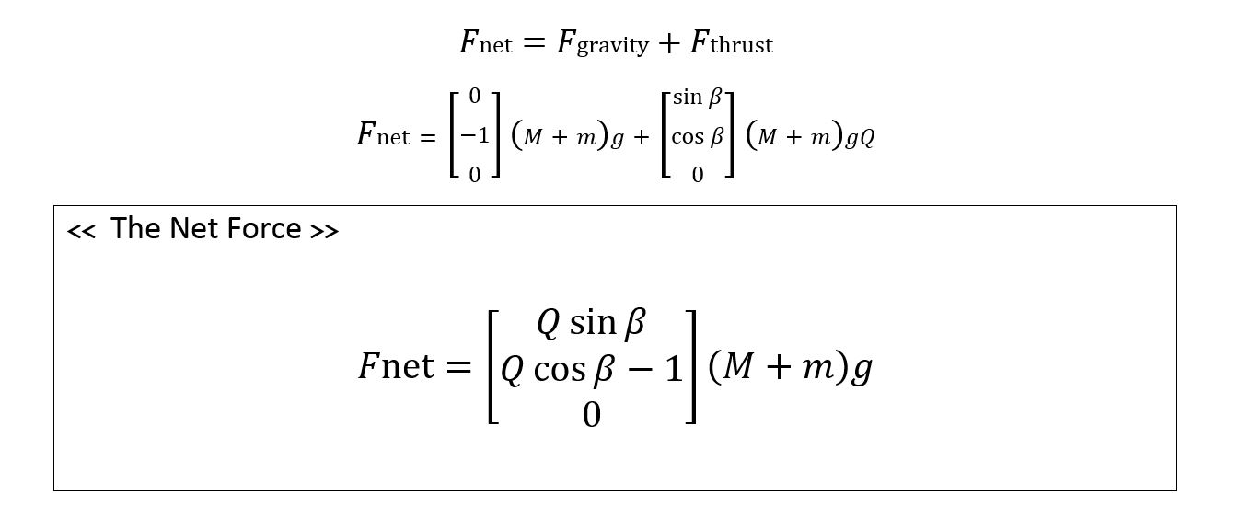
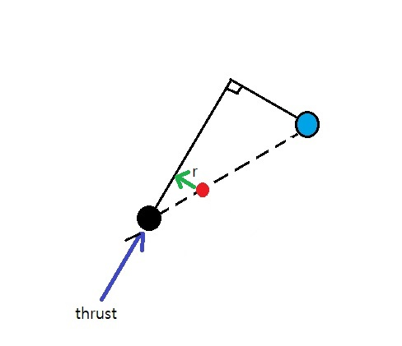
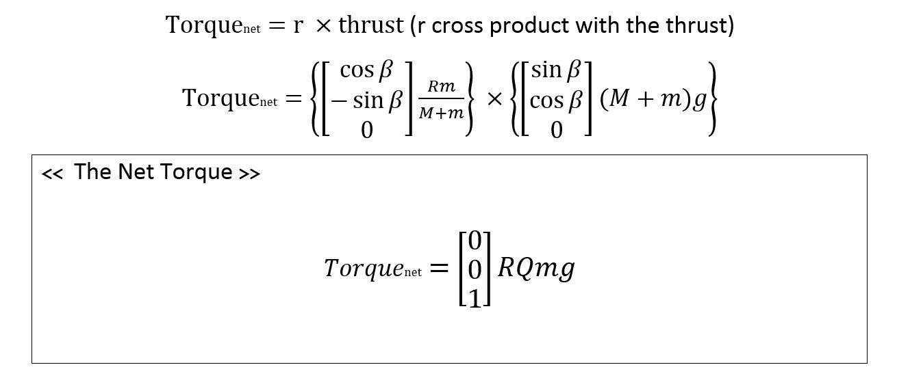
Mathematical Modeling

Slide 5
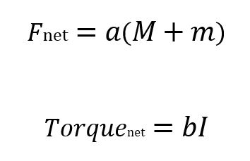
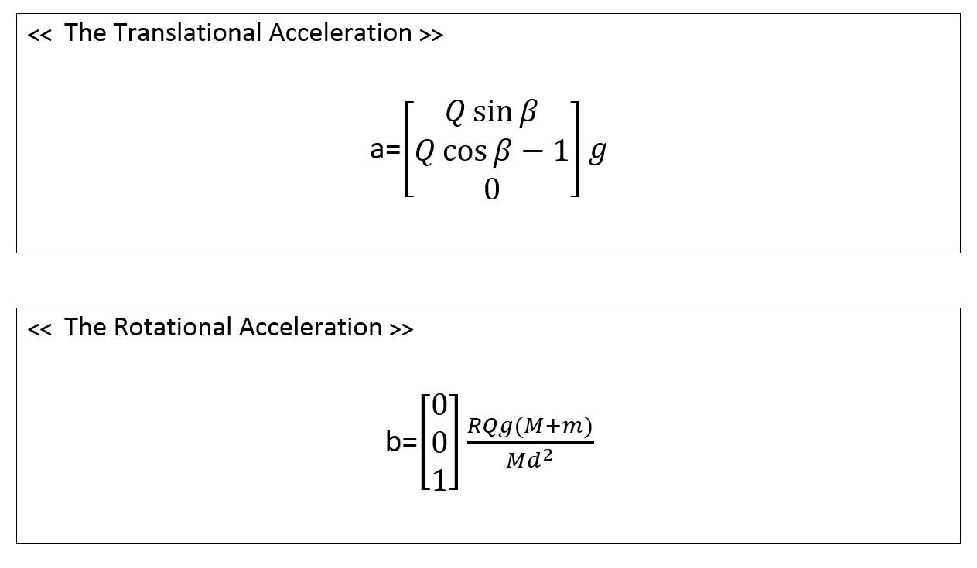

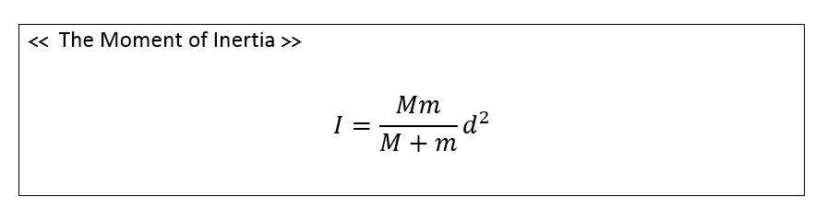
Mathematical Modeling

Slide 6
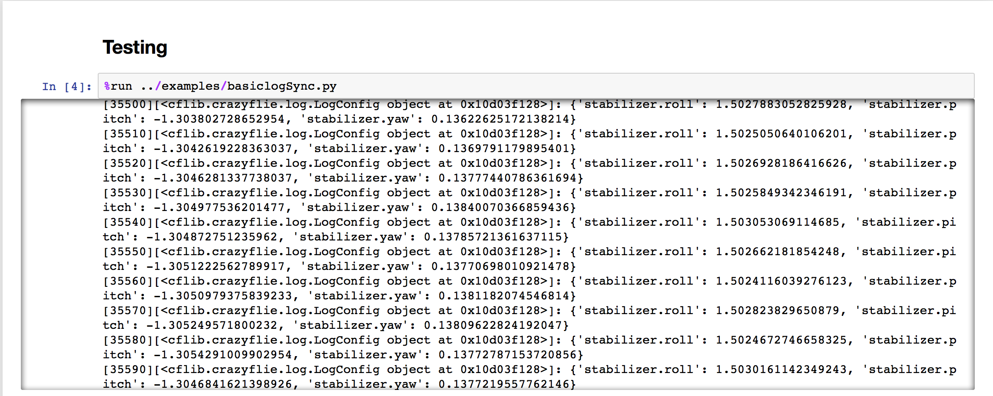
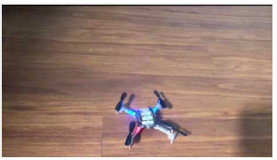


Drone Specifications
Getting yaw, roll and pitch measurements from the CF Client software
First CF flight test to make sure we use the resources to program and collect date from the drone using cf Client software:
https://youtu.be/7awN_Fga4PQ
Notes:
Show the resources to :
use/control/program the drone
Being able to work with the drone

Slide 7
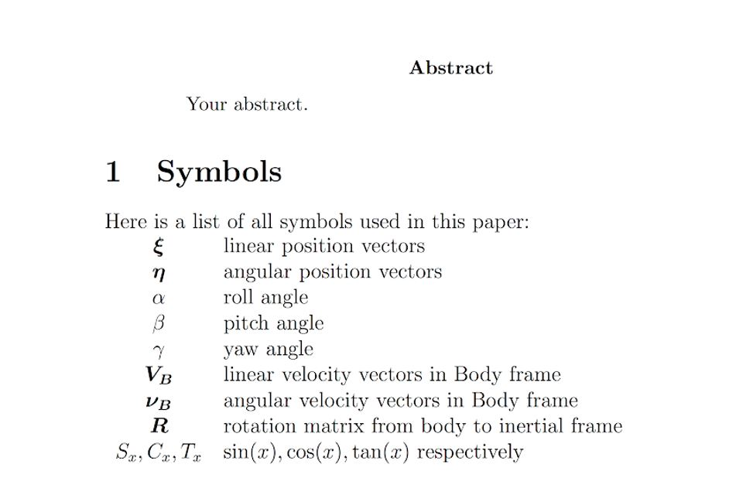
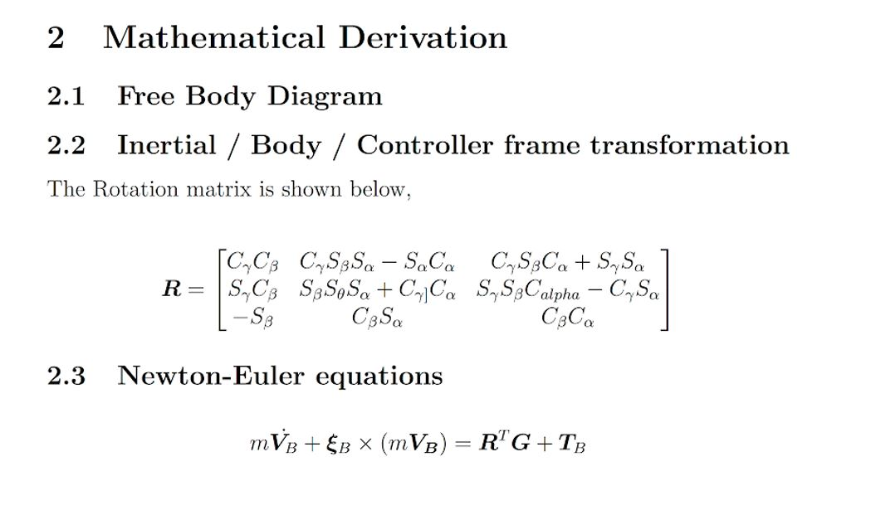
Documentation

Slide 8
References
T. Luukkonen, “Modelling and control of quadcopter,” Aalto School of Science, Aug. 2011.

